Slide 1
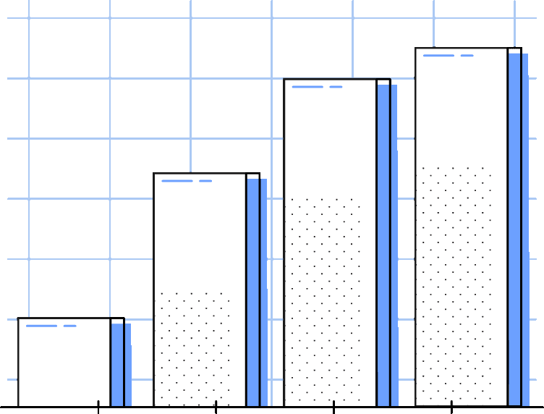
2024-17-04
Amazon Web Scraping And Visualization
Northeastern University
PRESENTED BY
Jay Shukla
NUID: 002619454

Slide 2

About The Project
Use Scrapy to mine data from Amazon
Clean the Raw data using Pandas and analyze it
Discover meaningful pattern and trends and report on it
2

Slide 3



Project Objectives
Amount of product on Amazon is very huge. So my focus: Laptops
Objective # 1
Objective # 2
Objective # 3
Scrape data of laptops for different brands
Clean the scraped data for analysis
Discover pattern and trends
3

Slide 4






USE CASES
Pricing Analysis
Customer Insights
Product development decisions
Inventory Management
Sales Forecasting
Brand Monitoring
4

Slide 5
TOOLS AND TECHNOLOGIES USED
5

Slide 6




6
Notes:
Open-source web crawling framework in Python
Extract, process and store structured data from websites
Built-in support for common web-related tasks
Fast and efficient with asynchronous request handling
Widely used for data mining and information processing.

Slide 7




7
Notes:
Open-source web crawling framework in Python
Extract, process and store structured data from websites
Built-in support for common web-related tasks
Fast and efficient with asynchronous request handling
Widely used for data mining and information processing.

Slide 8
Workflow
Web Scraping
Data Cleaning using
Pandas
Data Visualization using
Matplotlib and Seaborn
Documentation
Finding Patterns
Figure 1: Flowchart showing workflow of project
8

Slide 9
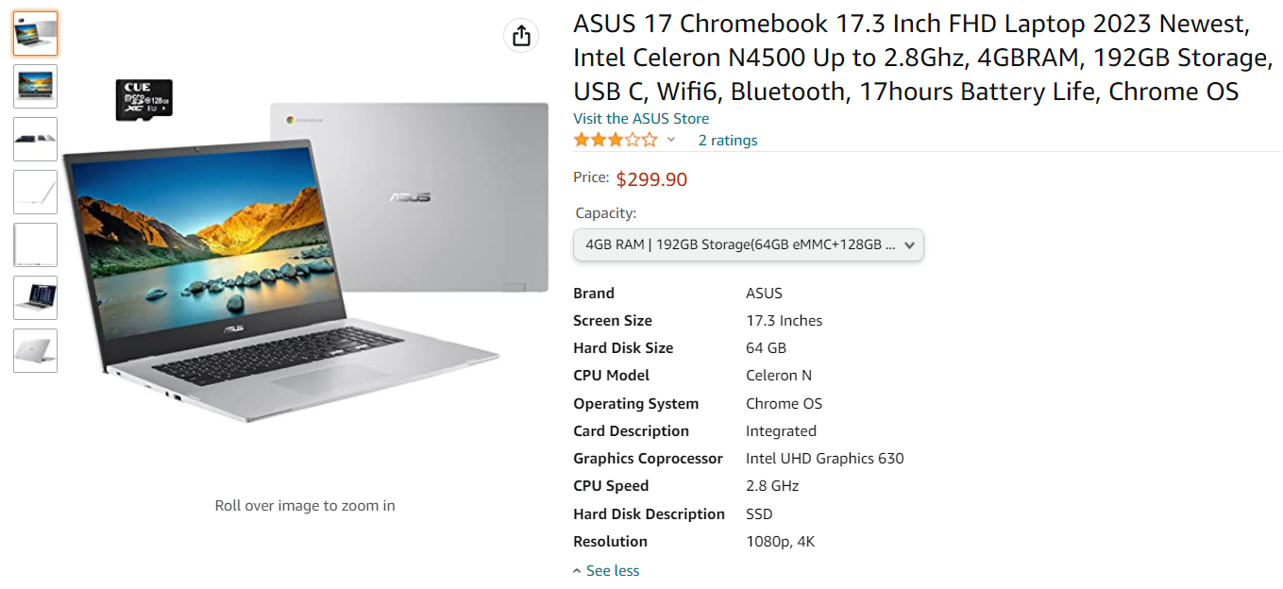
Web Scraping
9

Slide 10
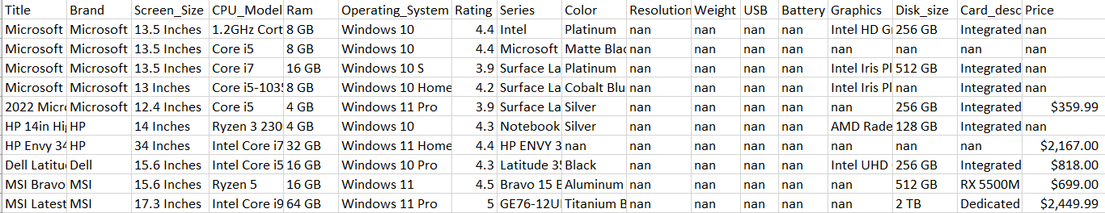
Amazon Laptop Data
Sample data
10

Slide 11
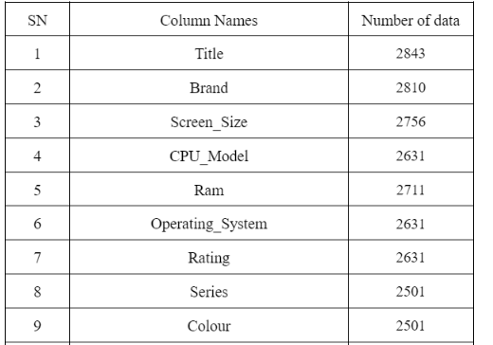
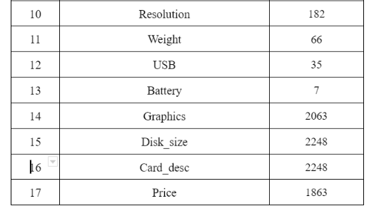
Amazon Laptop Data
11

Slide 12
Data Cleaning
Fill nan values in Rating column with 0
Drop rows with nan values in other columns
Converted data in RAM and Disk_Size column to numeric values
Removed duplicate rows
Removed irrelevant Columns/Features
12

Slide 13
Data Visualization
Matplotlib and Seaborn
Generates various types of plots and graphs
Integrates with other libraries such as NumPy, Pandas.
Offers customization and high-quality output.
Open-source data visualization in Python
50
40
30
20
10
0
Item 1
Item 2
Item 3
Item 4
Item 5
13
50%

Slide 14
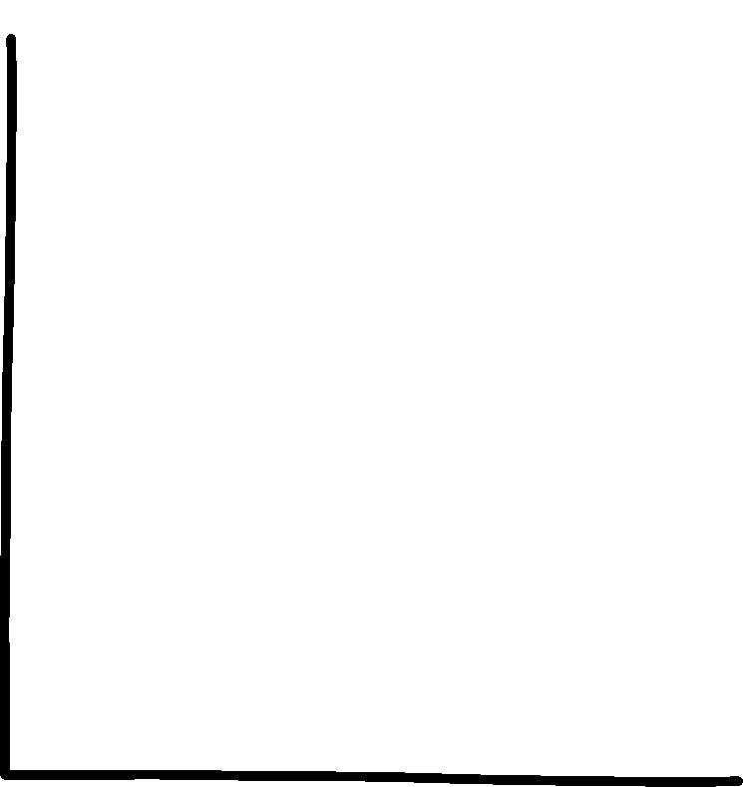

DATA VISUALIZATIONS
14

Slide 15
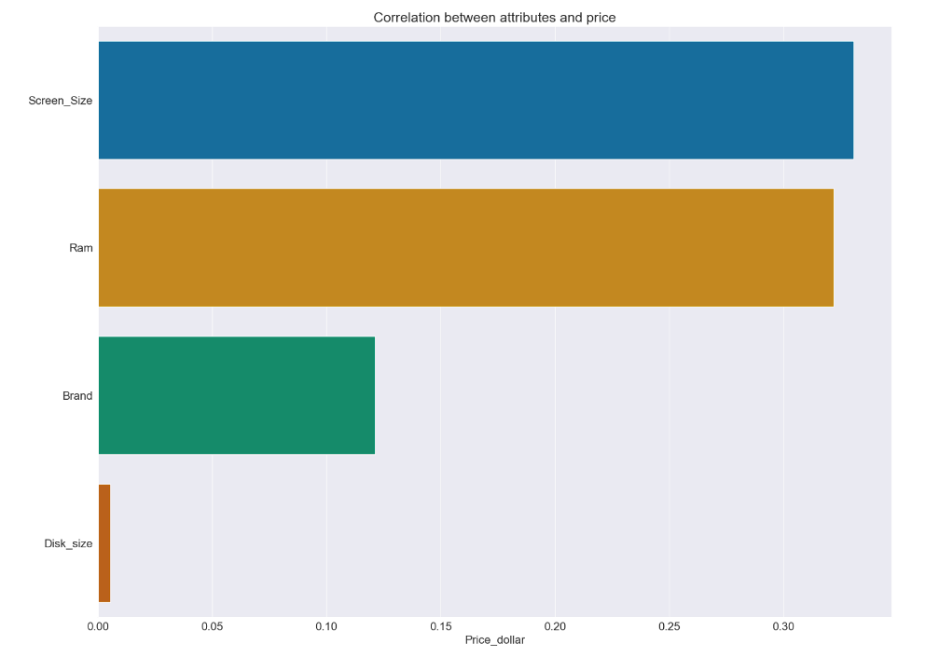
Correlation
The best attribute appears to be screen size to determine price.
High Correlation
Screen Size, RAM
Irrelevant
Disk Size
Medium Correlation
Brand
15

Slide 16
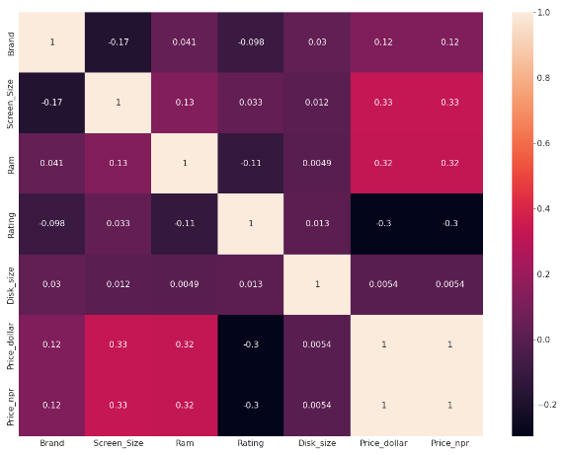
Correlation Heatmap
The best attribute appears to be screen size to determine price.
16

Slide 17
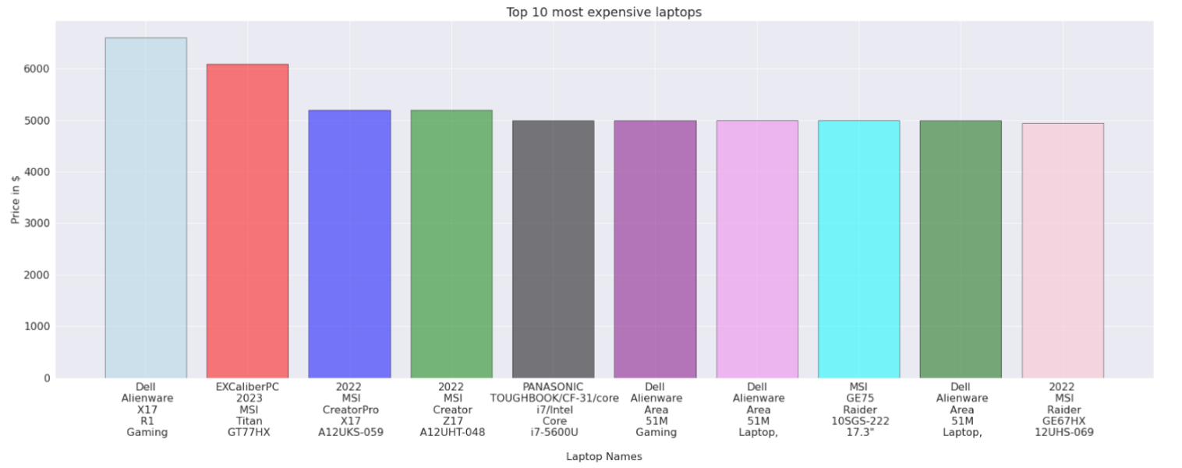
Top 10 Most Expensive Laptops
17

Slide 18
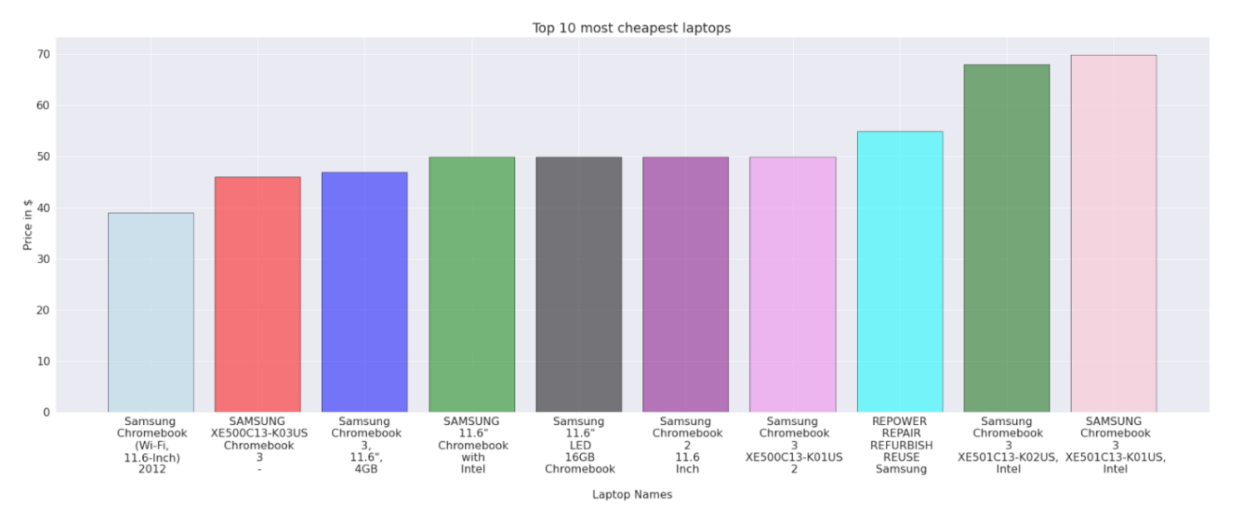
Top 10 Cheapest Laptops
18

Slide 19
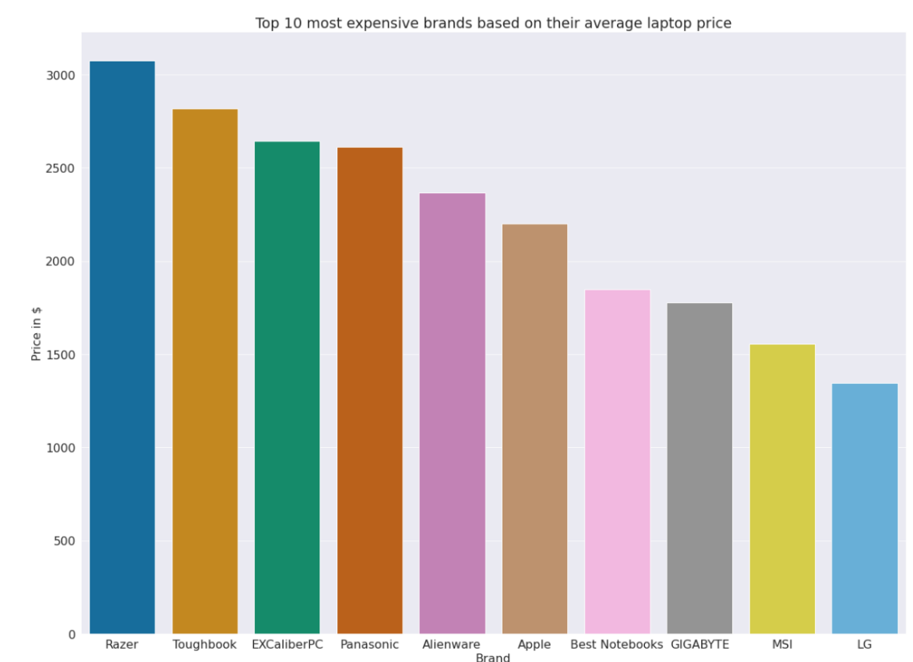
Top 10 Expensive Laptops Brands
19

Slide 20
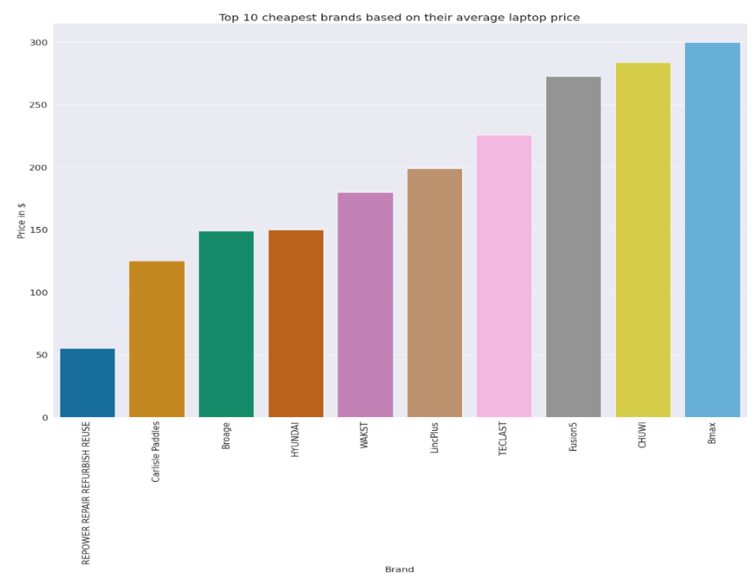
Top 10 Cheapest Laptops Brands
20

Slide 21

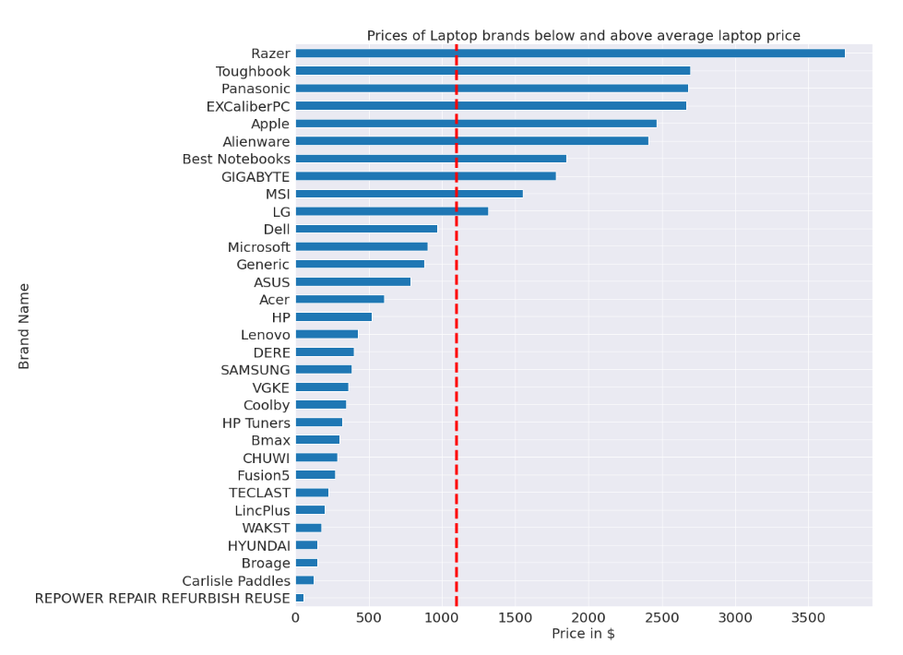
Average Price Of Different Brands
RAZER HAVE HIGHEST AVERAGE PRICE
Most Razer laptops have above average price
USED HAVE LEAST AVERAGE PRICE
Similar story to previous case
AVERAGE PRICE NEAR 1000 DOLLARS
Brands like acer have varied pricing so have low average
21

Slide 22
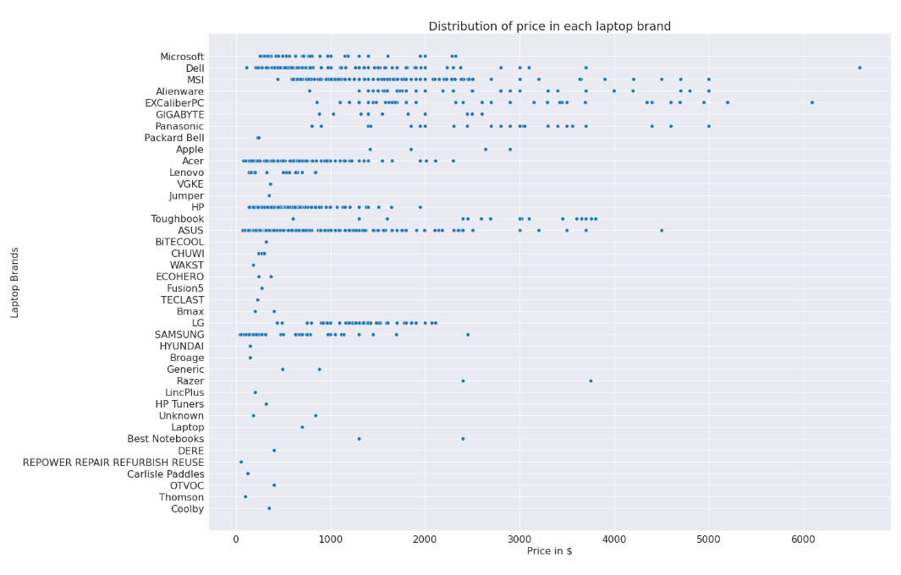
Distribution of Price Among Laptop Brands
Scatter plot of price against brands.
HIGH END
EXCALIBER PC
ALIENWARE
RAZER
ACROSS THE BOARD
DELL
ASUS
MSI
LOW END
LENOVO
SAMSUNG
22

Slide 23
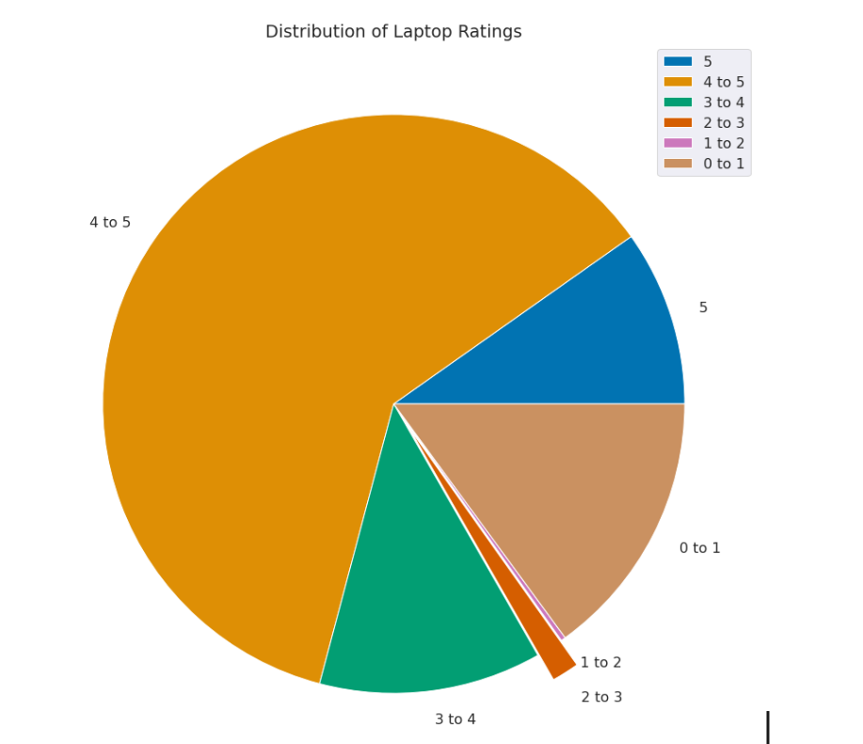
About the Ratings
Most are rated between 4 and 5 stars
Significant amount rated 0-1 stars
23

Slide 24
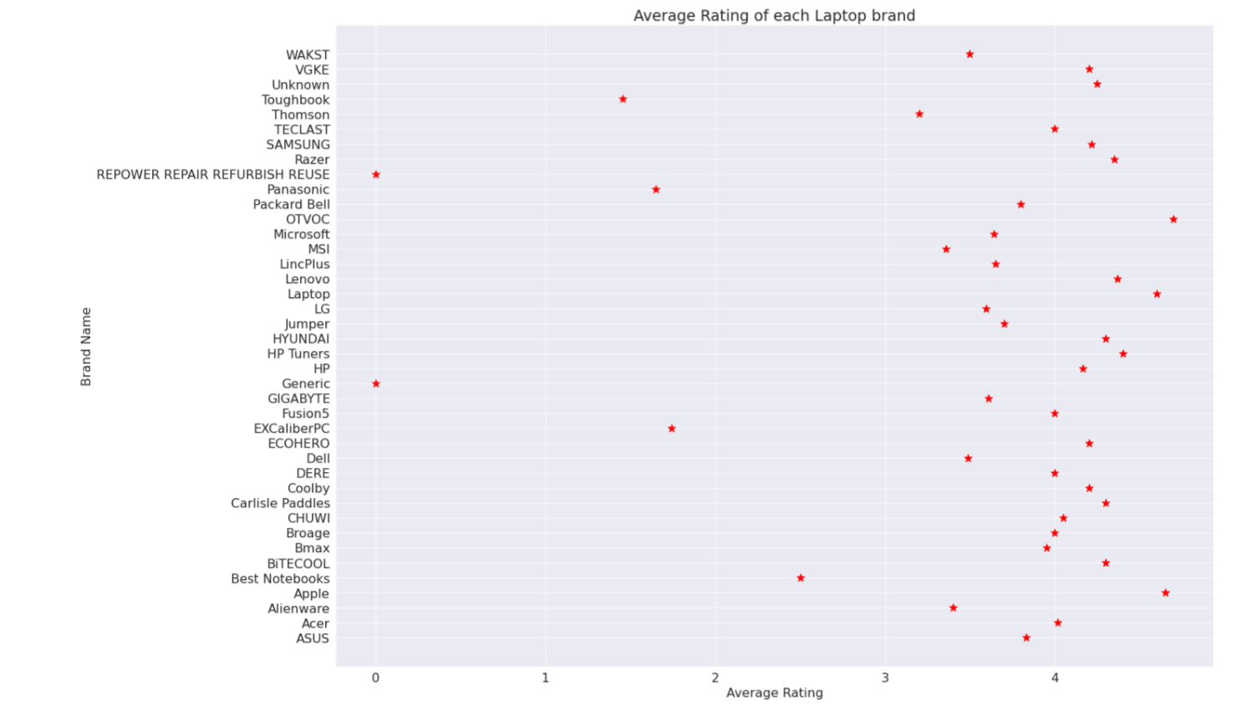
Average Rating Of Each Laptop Brand
OTVOC & APPLE HAD HIGHEST AVERAGE RATING
Over 4.0 rating
REFURBISH & GENERIC HAS LOWEST AVERAGE RATING
Not Rated
24
Notes:
A Generic PC, also known as ‘beige box’, ‘white box’ or ‘no name’ are made up of components from a variety of manufacturers. Usually built by the local computer shop, these boxes have no branding on them.
A refurbished item is a pre-owned product that's been evaluated, cleaned, repaired, upgraded (in some cases), and then resold. For computers and mobile devices, these products also have their data wiped and drives restored to the factory settings.

Slide 25
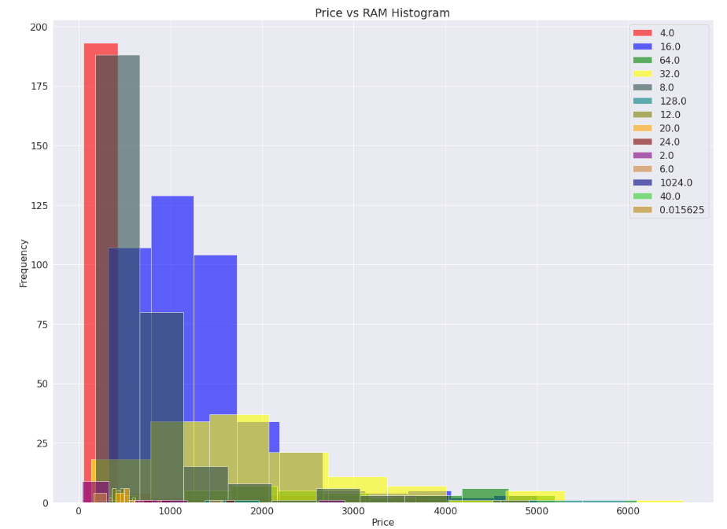
Price V/s RAM Histogram
Shows that the laptops price mostly depends on RAM size.
4 GB RAM is most common and cheapest, followed by 8 GB and 16 GB
1TB RAM laptops are most expensive
25

Slide 26



MAIN INSIGHTS
Price changes with change in Screen size, RAM and Brand.
Razer is most expensive laptop brand followed by Toughbook and ExCalliber.
Dell's Alienware and MSI's laptops take over top 10 most expensive laptops.
Most laptops have 4GB RAM and is cheaper comparatively.
Laptops with 32GB and 128GB RAM is expensive and less in number.
Samsung Chromebook takes over top 10 most cheapest laptops.
26

Slide 27

Challenges
Amazon has mechanisms to prevent scraping
Joint ventures (Sub Brands)
Irregularities in amazon pages
Sellers other than the authorized distributor
27

Slide 28
Conclusion
Scraped Amazon laptop data
Cleaned raw data
Visualized data using Matplotlib and Seaborn
Discovered insights and patterns
28

Slide 29
References
Scrapy Beginners Series Part 1 - First Scrapy Spider | ScrapeOps. (n.d.). https://scrapeops.io/python-scrapy-playbook/scrapy-beginners-guide/
Amazon.com: Laptop. (n.d.). https://www.amazon.com/s?k=laptop
30

Slide 30
THANK YOU
31

